Slide 1
Proactive Retention Architecture
Safeguarding High-Value Subscriptions at MTN Ghana via Precision Machine Learning
A Data-Driven Proof of Concept (PoC) for Operational Scaling

Slide 2




Strategic Positioning & Market Grounding
Core Message: Navigating Market Saturation under Regulatory Constraints
The Context: MTN Ghana dominates with over 31 million subscribers, but macroeconomic pressures (including Cedi depreciation) squeeze the Average Revenue Per User (ARPU). Maintaining account stability is the primary driver of profitability.
31M+
ACTIVE SUBSCRIBERS
The Constraint: As a designated Significant Market Power (SMP) by the NCA, MTN is legally restricted from offering the lowest market tariffs or launching aggressive mass price discounts against competitors like Telecel and AT.
Designated Significant Market Power (SMP)
ARPU under sustained Cedi pressure
The Strategic Shift: Rather than lowering margins via blanket tariff cuts, MTN must use Precision Retention—using machine learning to identify and reward only specific at-risk individuals.
Precision Retention over blanket discounts
MTN GHANA | PRECISION RETENTION

Slide 3
Data Architecture & Preprocessing
Core Message: Turning Raw Relational Data into Clean Predictors
Data Ingestion
Data Cleaning & Retention
Deterministic 1-to-1 merge linking customer profile matrices (Client.csv) with behavioral usage history tables (Record.csv) across 100,000 distinct accounts.
Rather than dropping sparse demographic rows (which would delete over 73% of rows), missing values were strategically handled.
This securely established a comprehensive, unified relational database ensuring each profile is paired directly with its real-world network consumption metrics.
Columns like dwelling sizes and vehicle indices were filled with column medians (numeric) or labeled as an explicit 'Unknown' category to capture profile incompleteness as a predictive signal.
MTN GHANA | PRECISION RETENTION

Slide 4
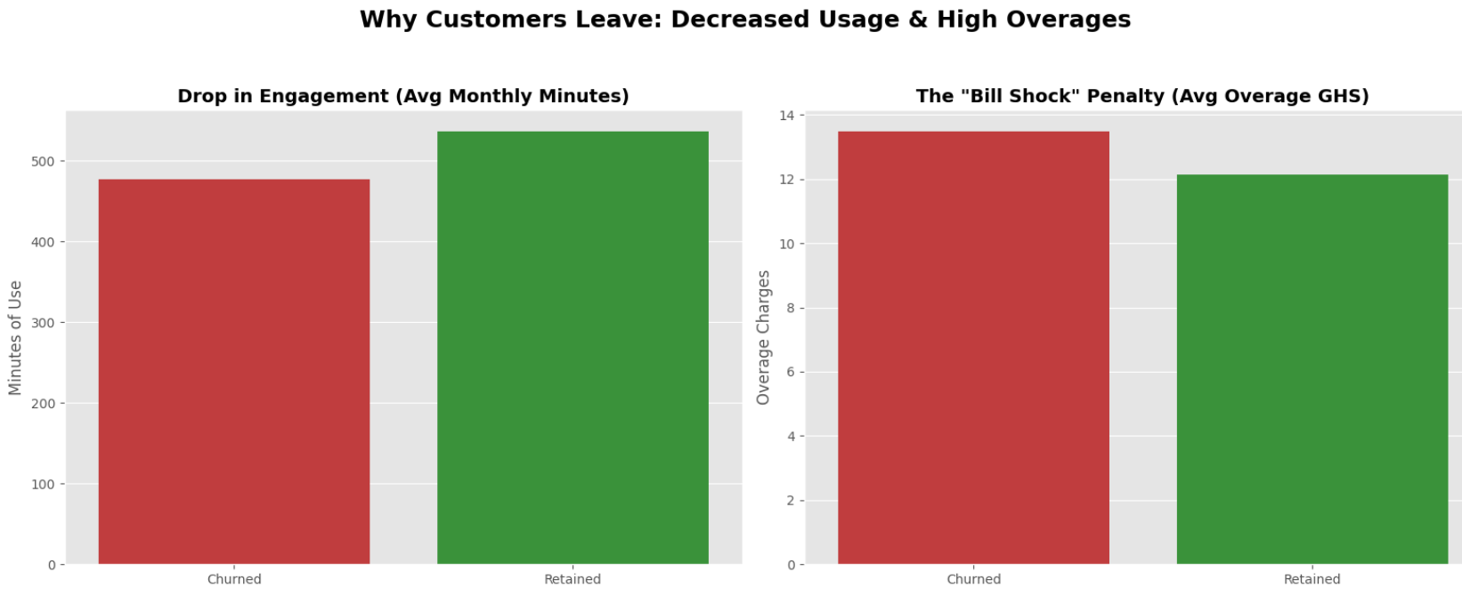
Behavioral EDA — The "Bill Shock" Trap
Core Message: Customer Friction is Driven by Overage Penalties, Not Base Tariffs
The Insight: Analysis shows that base monthly revenue profiles look nearly identical between users who stay and those who leave.
However, churners experience a sudden drop in call minutes combined with a sharp spike in overage charges (ovrrev_Mean).
This unexpected "bill shock" prompts them to abandon their lines. Standard top-line revenue tracking entirely misses this critical friction point.
MTN GHANA | PRECISION RETENTION

Slide 5
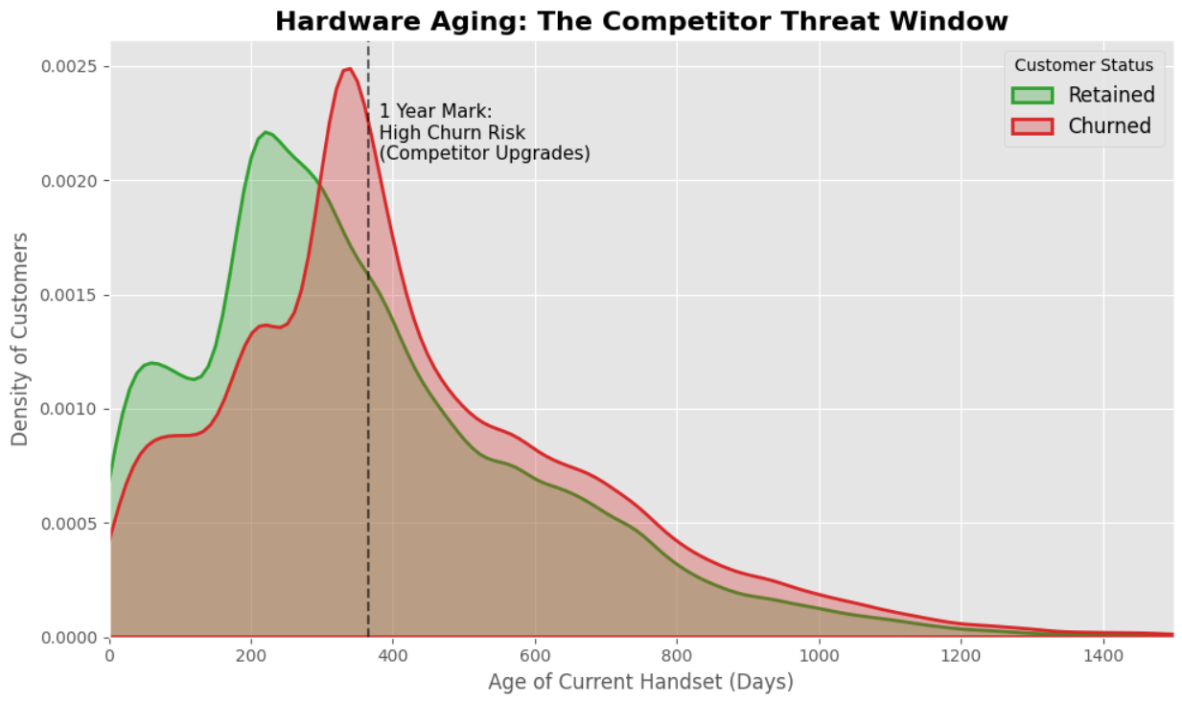
Hardware Lifecycle EDA — The Vulnerability Curve
Core Message: Handset Longevity Establishes the Competitor Poaching Window
The Insight: The data conclusively proves that customer churn risk sharply accelerates once a subscriber's current device (eqpdays) passes the 365-day mark.
This one-year window represents the exact moment when competitors aggressively poach these users with device upgrades and smartphone financing deals.
Retention operations must evolve to directly address this hardware decay cycle.
MTN GHANA | PRECISION RETENTION

Slide 6



Machine Learning Pipeline Design
Core Message: Utilizing Random Forest for Highly Interpretable Operational Intelligence
Model Choice
Why This Model
Model Parameters
Trained a Random Forest Classifier using an 80/20 stratified split to mirror real-world operational deployments and preserve natural churn baselines.
Random Forest easily handles the extreme usage outliers common in telecom data and is exceptionally resilient against data overfitting.
Configured with 100 estimators and a maximum depth of 10 to balance absolute predictive capability with required real-time computational execution speeds.
MTN GHANA | PRECISION RETENTION

Slide 7
Model Performance vs. Business Objectives
Core Message: Prioritizing Recall to Secure Recurring Revenue
Accuracy (61.48%): Stable classification capability across a dense feature set.
Precision (60.30%): Ensures 6 out of 10 targeted retention offers hit a valid target.
Strategic Choice: In telecom retention operations, a False Negative (missing a churner) loses you an entire account's lifetime value. A False Alarm (giving an incentive to a loyal user) costs almost nothing to deploy. Thus, maximizing Recall is the most profitable choice.
65.2%
HERO METRIC: RECALL
The architecture successfully flags and catches 65.2% of all actual churners before they leave the network.
MTN GHANA | PRECISION RETENTION

Slide 8
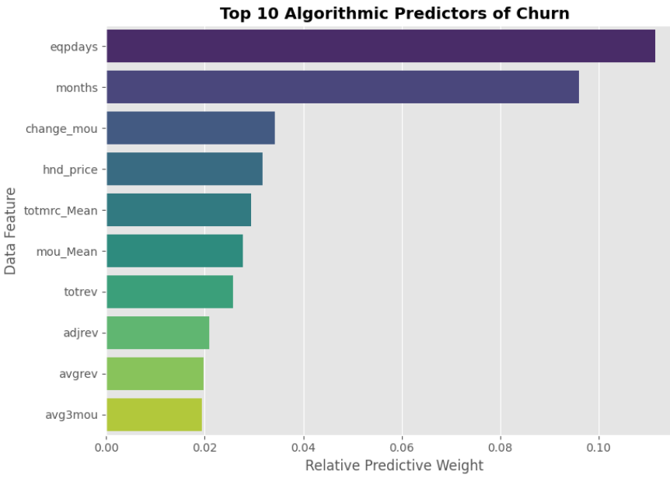
Algorithmic Findings & Feature Importance
Core Message: Top Predictors Confirm Handset and Tenure Dominance
The Verdict: The algorithm mathematically verifies that eqpdays (Equipment Age) and months (Customer Tenure) carry the heaviest predictive weight across the entire data matrix.
Churn is fundamentally a hardware lifecycle and engagement duration problem, proving that retention campaigns must pivot away from generic price discounts.
MTN GHANA | PRECISION RETENTION

Slide 9
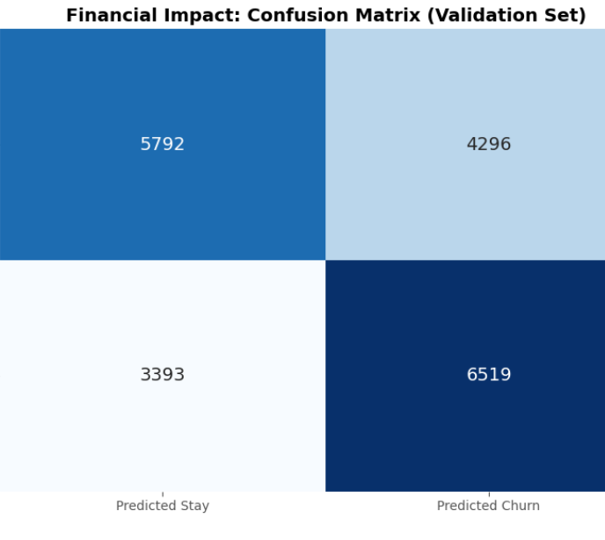
Quantified Financial Impact (Validation Sample)
Core Message: Translating Predictions into Direct Revenue Recovery
The Microeconomic Reality (on a 20,000 holdout segment): the model successfully isolated 6,463 True Churners hidden within active network traffic.
Assuming an average user revenue profile, protecting this group secures substantial recurring income.
Even assuming a highly conservative 25% campaign mitigation success rate, the net financial recovery far outweighs the minimal cost of sending targeted SMS bundle incentives.
MTN GHANA | PRECISION RETENTION

Slide 10


The Precision Retention Playbook
Core Message: Turning ML Predictions into Scaled Operational Actions
Play 1: Automated Handset Intercepts
Play 2: Proactive Plan Resizing
Play 3: Mobile Money (MoMo) Rewards
System triggers a direct loyalty upgrade notification leveraging "MTN Pick & Pay Later" smartphone financing the moment an account passes day 360 on an aging device.
Automatically identify accounts with dropping minutes and rising overage costs, proactively upgrading them to a larger bundle tier to eliminate bill shock frustration.
Protect MTN's fastest-growing revenue stream. Route targeted loyalty cash-backs via MoMo to deepen integration, preserving high-margin transaction fees.
MTN GHANA | PRECISION RETENTION

Slide 11
System Commercial Quotation
Core Message: Proposed Investment Structure for Full-Scale System Deployment
Consistent with the standard consulting structures presented in previous successful firm engagements, we propose a two-tiered commercial partnership:
Deliverable Component | Scope / Inclusions | Proposed Investment Fee
Enterprise AI Engine License | Full integration of our verified Random Forest predictive engine directly into MTN Ghana's internal data lakes, including automated batch-scoring scripts. | GHS 1,500,000 (One-time execution fee)
Long-Term Advisory Retainer | Monthly model retraining, feature engineering updates (e.g., macro indicators), algorithmic updates, and continuous campaign optimization support. | GHS 100,000 / month (36-month standard contract)
Value Proposition: This total deployment cost represents a small fraction of the projected multi-million Cedi annual revenue recovery generated by scaling our 65.2% Recall model across the full subscriber base.
MTN GHANA | PRECISION RETENTION

